Slide 1
AI

Slide 2
Artificial Intelligence
First Order Logic (Ch. 8)

Slide 3
Outline
Why FOL?
Syntax and semantics of FOL
Using FOL
Wumpus world in FOL
Knowledge engineering in FOL

Slide 4
Pros and cons of propositional logic
☺ Propositional logic is declarative
☺ Propositional logic allows partial/disjunctive/negated information
(unlike most data structures and databases)
Propositional logic is compositional:
meaning of B_{1,1} ∧ P_{1,2} is derived from meaning of B_{1,1} and of P_{1,2}
☺ Meaning in propositional logic is context-independent
(unlike natural language, where meaning depends on context)
☹ Propositional logic has very limited expressive power
(unlike natural language)
E.g., cannot say "pits cause breezes in adjacent squares“
except by writing one sentence for each square

Slide 5
First-order logic
Whereas propositional logic assumes the world contains facts,
first-order logic (like natural language) assumes the world contains
Objects: people, houses, numbers, colors, baseball games, wars, …
Relations: red, round, prime, brother of, bigger than, part of, comes between, …
Functions: father of, best friend, one more than, plus, …

Slide 6
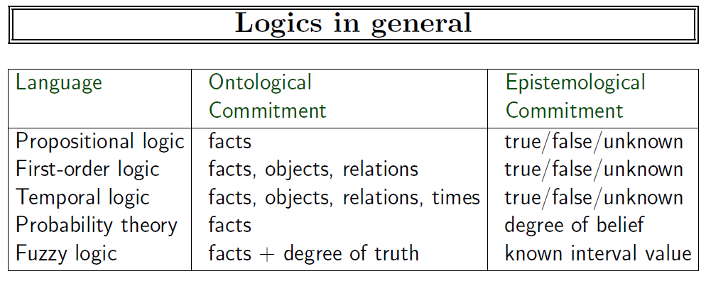

Slide 7
Syntax of FOL: Basic elements
Constants KingJohn, 2, CU,...
Predicates Brother, >,...
Functions Sqrt, LeftLegOf,...
Variables x, y, a, b,...
Connectives ¬, ⇒, ∧, ∨, ⇔
Equality =
Quantifiers ∀, ∃

Slide 8
Atomic sentences
Atomic sentence = predicate (term₁,...,term_{n}) or term₁ = term₂
Term = function (term₁,...,term_{n}) or constant or variable
E.g., Brother(KingJohn,RichardTheLionheart) > (Length(LeftLegOf(Richard)), Length(LeftLegOf(KingJohn)))

Slide 9
Complex sentences
Complex sentences are made from atomic sentences using connectives
¬S, S₁ ∧ S₂, S₁ ∨ S₂, S₁ ⇒ S₂, S₁ ⇔ S₂,
E.g. Sibling(KingJohn,Richard) ⇒ Sibling(Richard,KingJohn)
>(1,2) ∨ ≤ (1,2)
>(1,2) ∧ ¬ >(1,2)

Slide 10
Models in FOL
Constants
exact mapping between constants and objects
m(Mary) = x₁
Predicates
m(CapitalOf) = ((x₁,y₁), (x₂,y₂), …)

Slide 11
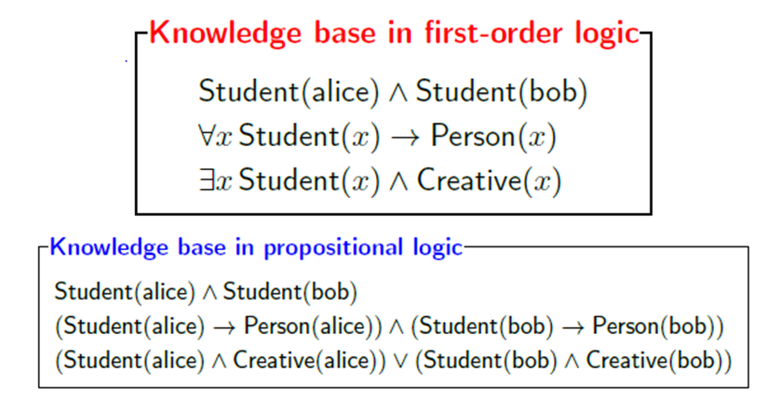
FOL vs Propositional Logic
FOL is just a fancier way to write propositional logic statements (propositionalization)
[Example from Percy Liang]

Slide 12
Truth in first-order logic
Sentences are true with respect to a model and an interpretation
Model contains objects (domain elements) and relations among them
Interpretation specifies referents for
constant symbols → objects
predicate symbols → relations
function symbols → functional relations
An atomic sentence predicate(term₁,...,term_{n}) is true
iff the objects referred to by term₁,...,term_{n}
are in the relation referred to by predicate

Slide 13
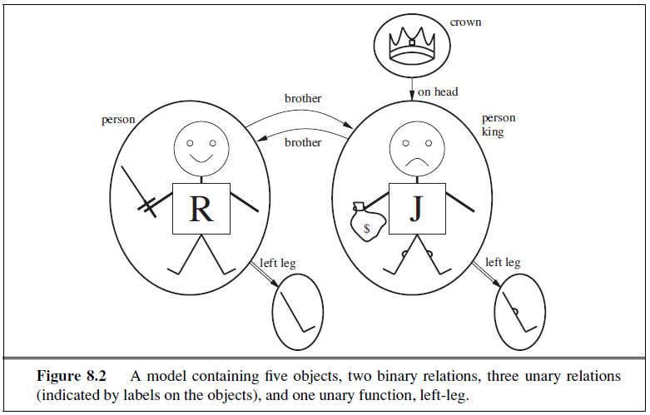
Models for FOL: Example

Slide 14
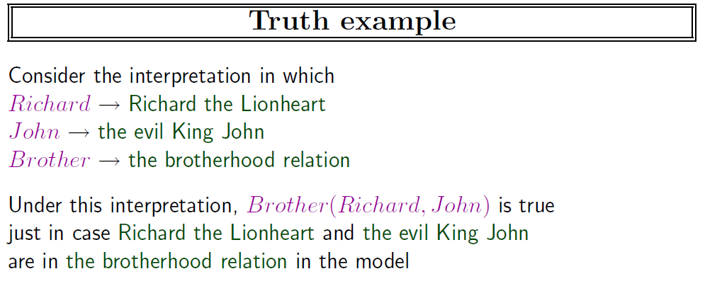

Slide 15
Universal quantification
∀<variables> <sentence>
Everyone at CU is smart:
∀x At(x,CU) ⇒ Smart(x)
∀x P is true in a model m iff P is true with x being each possible object in the model
Roughly speaking, equivalent to the conjunction of instantiations of P
At(KingJohn,CU) ⇒ Smart(KingJohn)
∧ At(Richard,CU) ⇒ Smart(Richard)
∧ At(CU,CU) ⇒ Smart(CU)
∧ ...

Slide 16
A common mistake to avoid
Typically, ⇒ is the main connective with ∀
Common mistake: using ∧ as the main connective with ∀:
∀x At(x,CU) ∧ Smart(x)
means “Everyone is at CU and everyone is smart”

Slide 17
Existential quantification
∃<variables> <sentence>
Someone at CU is smart:
∃x At(x,CU) ∧ Smart(x)$
∃x P is true in a model m iff P is true with x being some possible object in the model
Roughly speaking, equivalent to the disjunction of instantiations of P
At(KingJohn,CU) ∧ Smart(KingJohn)
∨ At(Richard,CU) ∧ Smart(Richard)
∨ At(CU,CU) ∧ Smart(CU)
∨ ...

Slide 18
Another common mistake to avoid
Typically, ∧ is the main connective with ∃
Common mistake: using ⇒ as the main connective with ∃:
∃x At(x,CU) ⇒ Smart(x)
is true if there is anyone who is not at CU!

Slide 19
Properties of quantifiers
∀x ∀y is the same as ∀y ∀x
∃x ∃y is the same as ∃y ∃x
∃x ∀y is not the same as ∀y ∃x
∃x ∀y Loves(x,y)
“There is a person who loves everyone in the world”
∀y ∃x Loves(x,y)
“Everyone in the world is loved by at least one person”
Quantifier duality: each can be expressed using the other
∀x Likes(x,IceCream) ¬∃x ¬Likes(x,IceCream)
∃x Likes(x,Broccoli) ¬∀x ¬Likes(x,Broccoli)

Slide 20
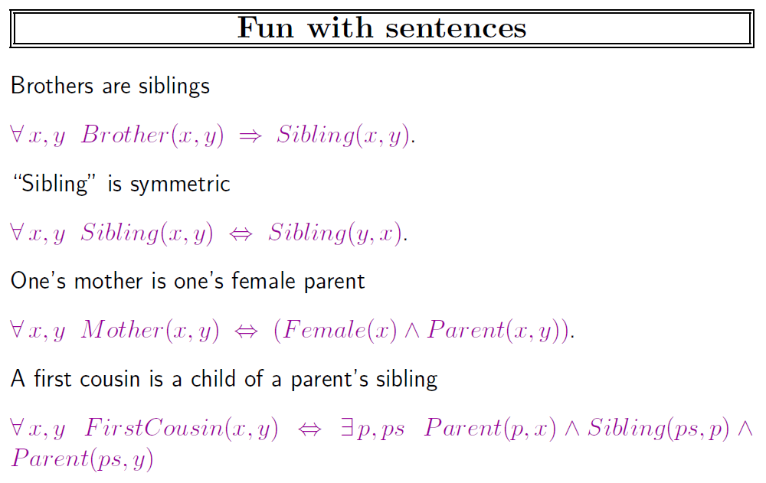

Slide 21
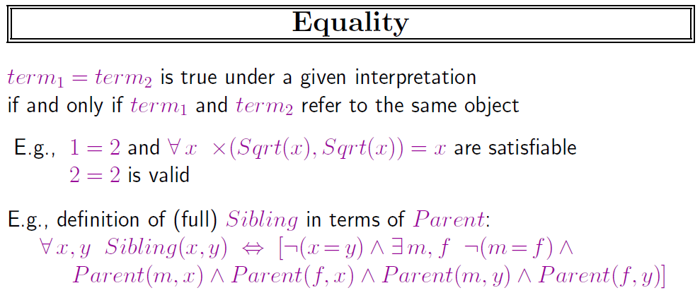

Slide 22
Using FOL
The kinship domain:
Brothers are siblings
∀x,y Brother(x,y) ⇔ Sibling(x,y)
One's mother is one's female parent
∀m,c Mother(c) = m ⇔ (Female(m) ∧ Parent(m,c))
“Sibling” is symmetric
∀x,y Sibling(x,y) ⇔ Sibling(y,x)

Slide 23
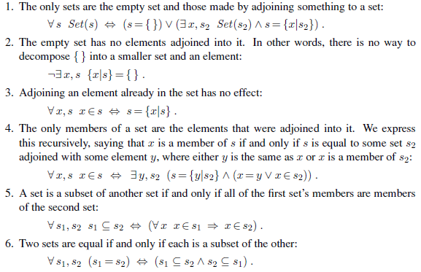
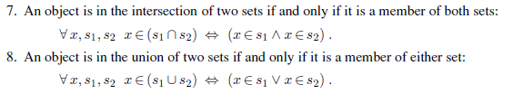

Slide 24
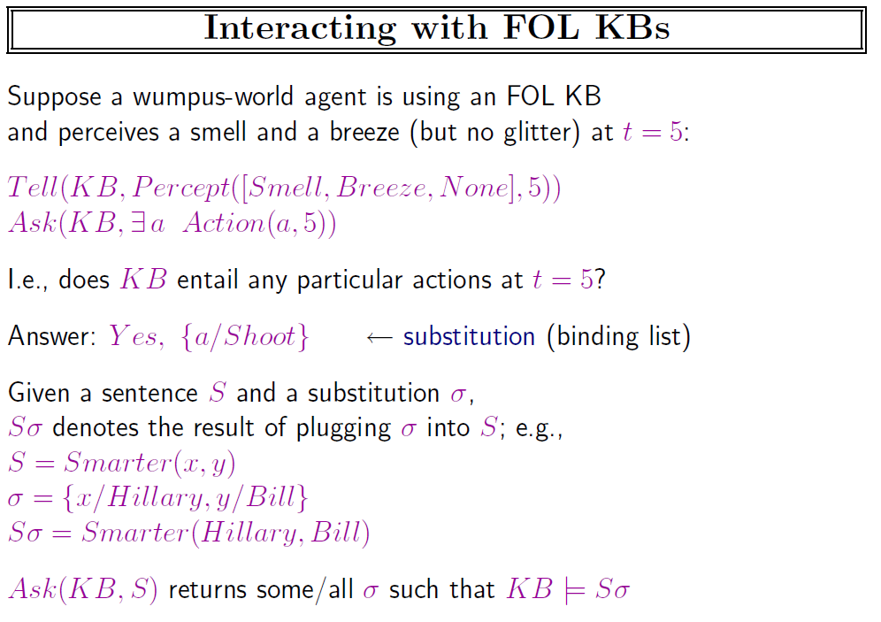

Slide 25
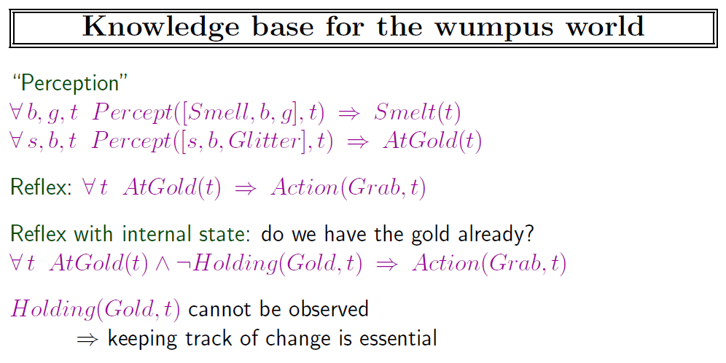

Slide 26
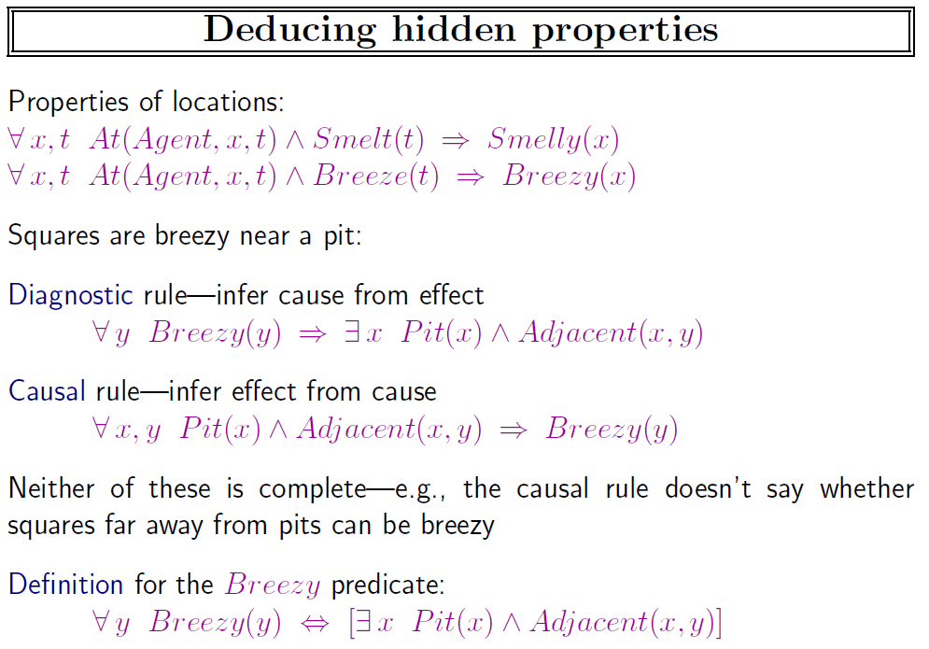

Slide 27
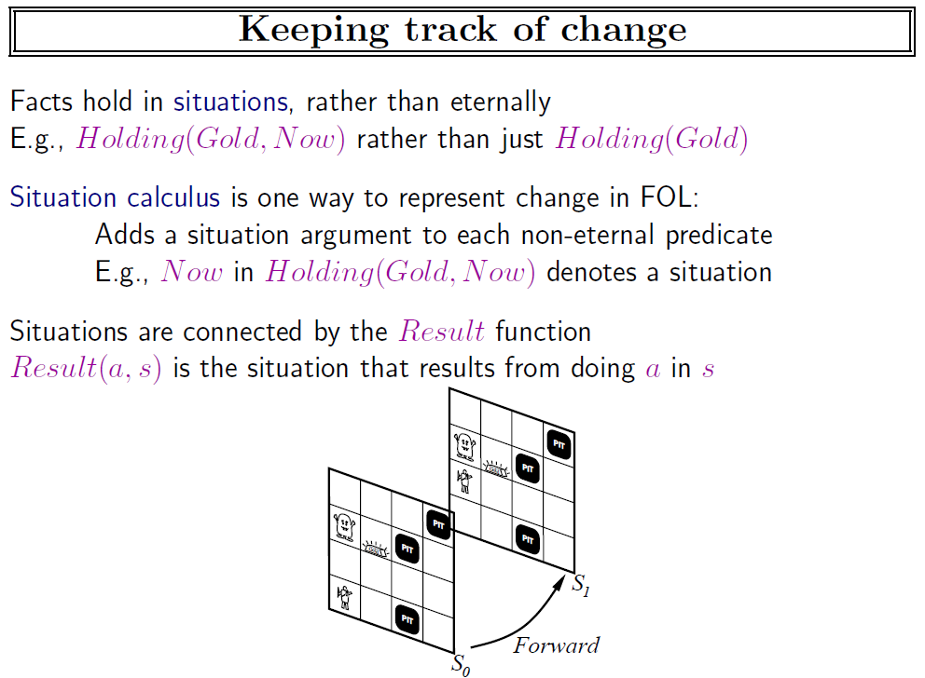

Slide 28
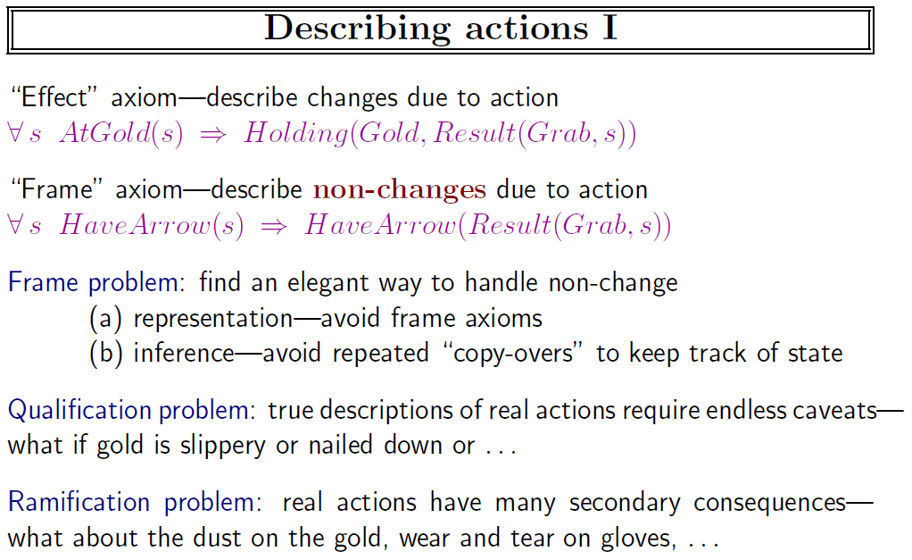

Slide 29
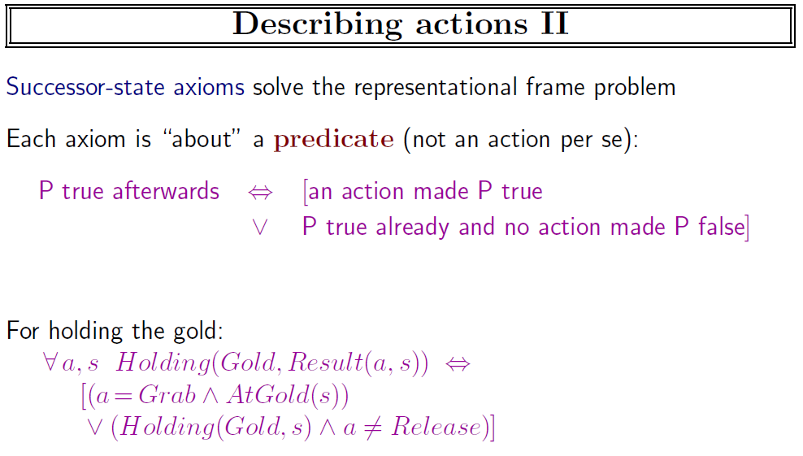

Slide 30
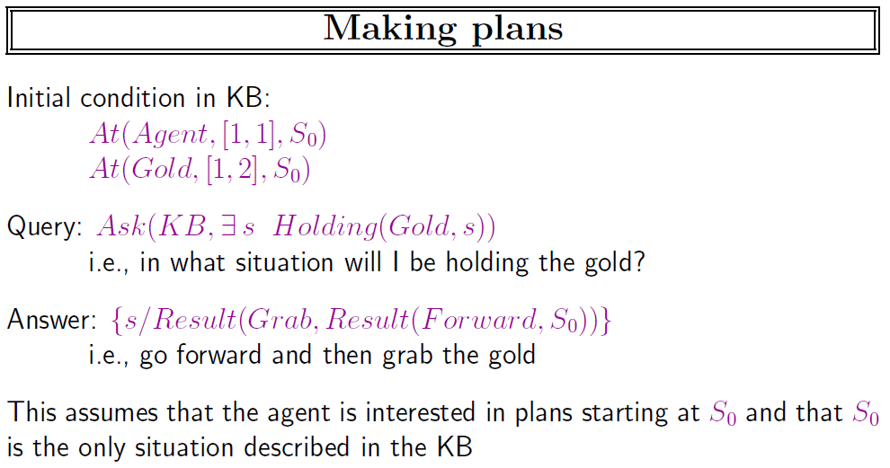

Slide 31
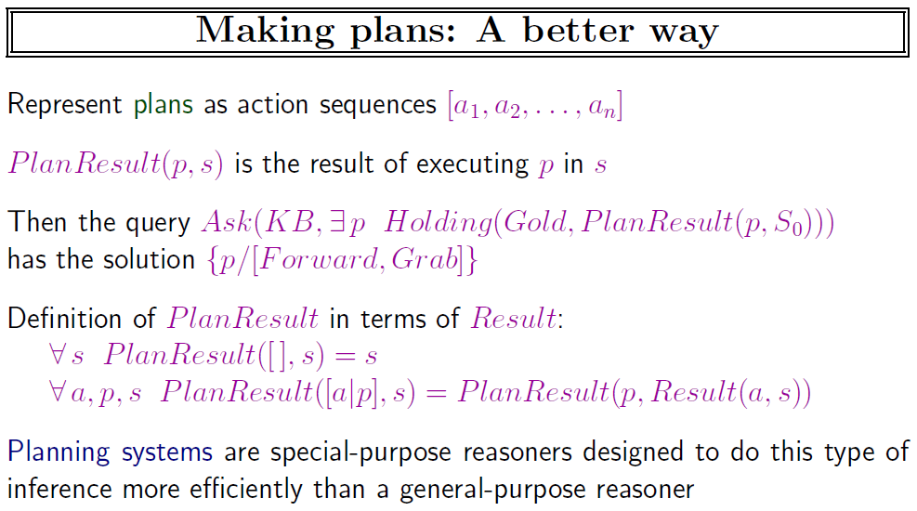

Slide 32
Knowledge engineering in FOL
Identify the task
Assemble the relevant knowledge
Decide on a vocabulary of predicates, functions, and constants
Encode general knowledge about the domain
Encode a description of the specific problem instance
Pose queries to the inference procedure and get answers
Debug the knowledge base

Slide 33
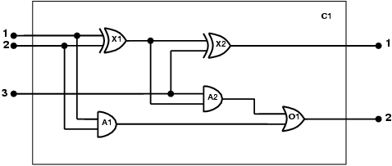
The electronic circuits domain
One-bit full adder

Slide 34

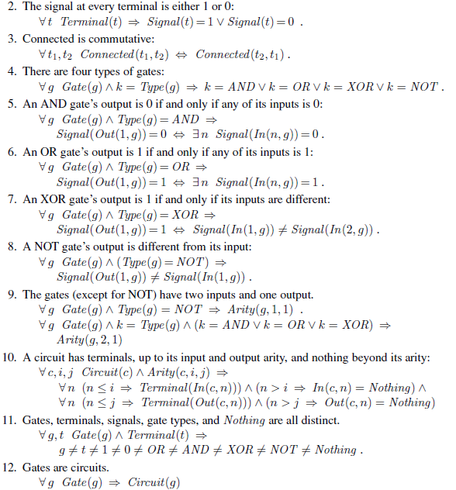

Slide 35
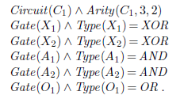
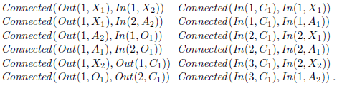
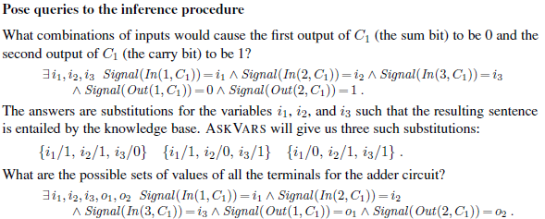

Slide 36
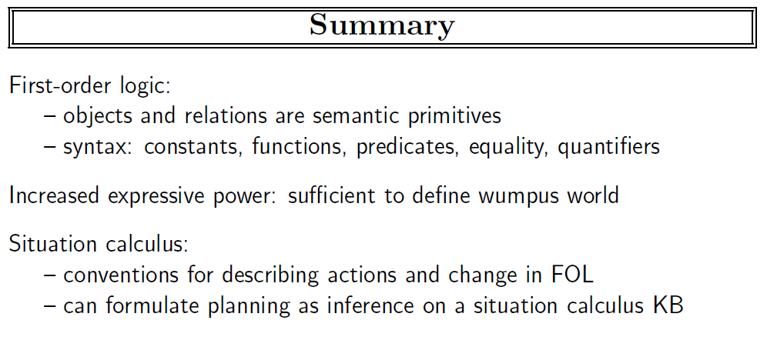

Slide 37
Artificial Intelligence
First Order Logic Problem (from 3.6.2)

Slide 38
First Order Logic
NACLO problem from 2014
Author: Ben King
http://www.nacloweb.org/resources/problems/2014/N2014-H.pdf
http://www.nacloweb.org/resources/problems/2014/N2014-HS.pdf

Slide 39
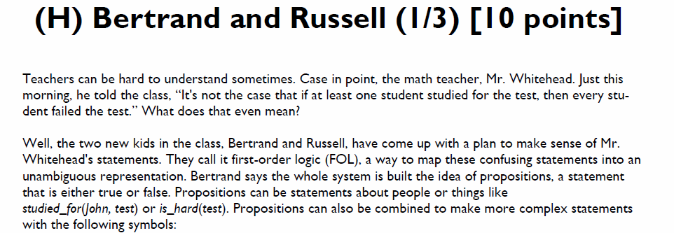
First Order Logic

Slide 40
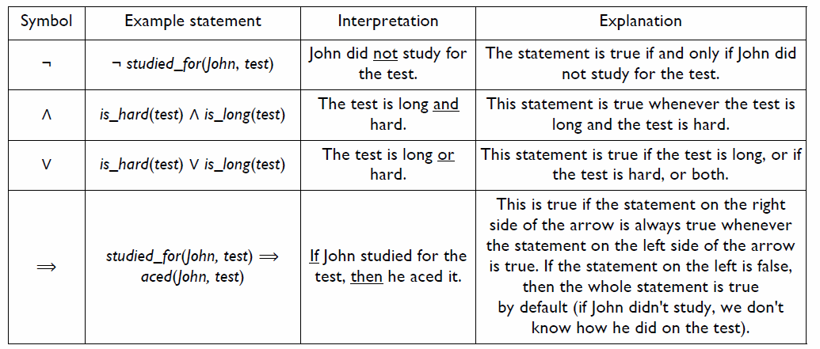

Slide 41
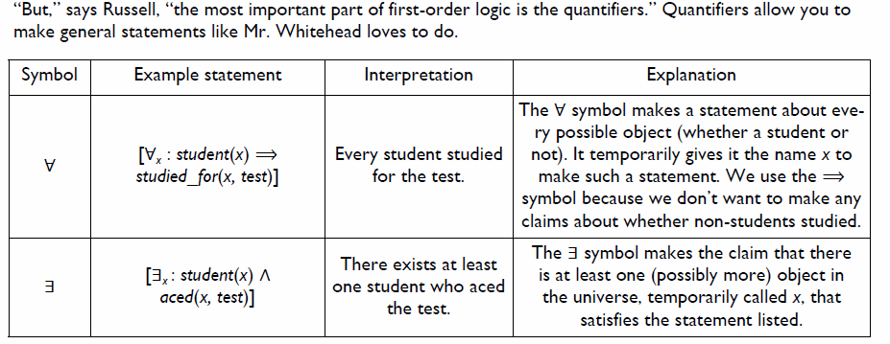

Slide 42
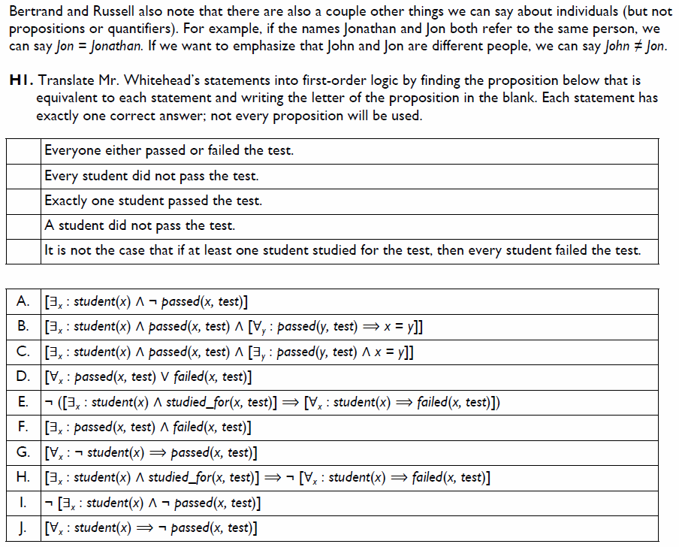

Slide 43
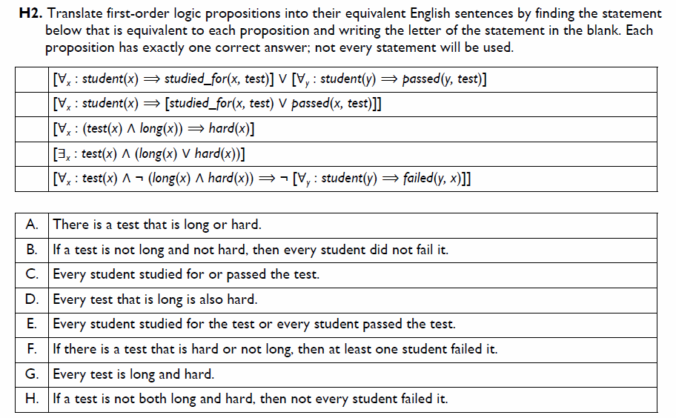

Slide 44

Solutions

Slide 45
AI

Slide 46
Artificial Intelligence
Inference in FOL (Ch. 9)

Slide 47
Outline
Reducing first-order inference to propositional inference
Unification
Generalized Modus Ponens
Forward chaining
Backward chaining
Resolution

Slide 48
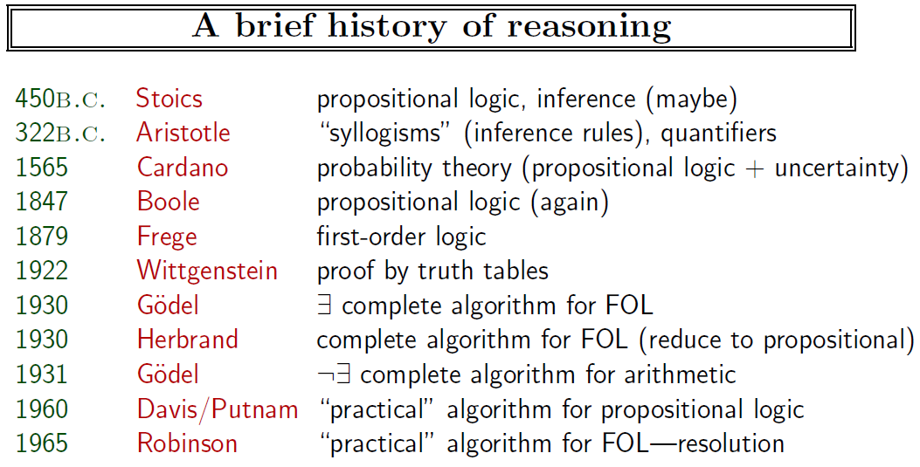

Slide 49
Modus Ponens
Modus ponens:
α
α ⇒ β
β
Example:
Cat(Martin)
∀ x: Cat(x) ⇒ EatsFish(x)
EatsFish(Martin)

Slide 50
FOL Examples
Brothers are siblings
∀x,y Brother(x,y) ⇒ Sibling(x,y)
One's mother is one's female parent
∀m,c Mother(c) = m ⇔ (Female(m) ∧ Parent(m,c))
“Sibling” is symmetric
∀x,y Sibling(x,y) ⇔ Sibling(y,x)

Slide 51
Inference
Forward chaining
as individual facts are added to the database, all derived inferences are generated
Backward chaining
starts from queries
Example: the Prolog programming language
Prolog example
father(X, Y) :- parent(X, Y), male(X). parent(john, bill). parent(jane, bill). female(jane). male (john). ?- father(M, bill).

Slide 52
Universal Instantiation
Every instantiation of a universally quantified sentence is entailed by it:
∀v α
Subst({v/g}, α)
for any variable v and ground term g
E.g., ∀x Cat(x) ∧ Fish(y) ⇒ Eats(x,y) yields:
Cat(Martin) ∧ Fish(Blub) ⇒ Eats(Martin,Blub)

Slide 53
Existential Instantiation
For any sentence α, variable v, and constant symbol k that does not appear elsewhere in the knowledge base:
∃v α
Subst({v/k}, α)
E.g., ∃x Cat(x) ∧ EatsFish(x) yields:
Cat(C₁) ∧ EatsFish(C₁)
provided C₁ is a new constant symbol, called a Skolem constant

Slide 54
Universal instantiation (UI)
Every instantiation of a universally quantified sentence is entailed by it:
∀v α Subst({v/g}, α)
for any variable v and ground term g
E.g., ∀x King(x) ∧ Greedy(x) ⇒ Evil(x) yields:
King(John) ∧ Greedy(John) ⇒ Evil(John)
King(Richard) ∧ Greedy(Richard) ⇒ Evil(Richard)
King(Father(John)) ∧ Greedy(Father(John)) ⇒ Evil(Father(John))

Slide 55
Existential instantiation (EI)
For any sentence α, variable v, and constant symbol k that does not appear elsewhere in the knowledge base:
∃v α
Subst({v/k}, α)
E.g., ∃x Crown(x) ∧ OnHead(x,John) yields:
Crown(C₁) ∧ OnHead(C₁,John)
provided C₁ is a new constant symbol, called a Skolem constant

Slide 56
Reduction to propositional inference
Suppose the KB contains just the following:
∀x King(x) ∧ Greedy(x) ⇒ Evil(x)
King(John)
Greedy(John)
Brother(Richard,John)
Instantiating the universal sentence in all possible ways, we have:
King(John) ∧ Greedy(John) ⇒ Evil(John)
King(Richard) ∧ Greedy(Richard) ⇒ Evil(Richard)
King(John)
Greedy(John)
Brother(Richard,John)
The new KB is propositionalized: proposition symbols are
King(John), Greedy(John), Evil(John), King(Richard), etc.

Slide 57
Reduction contd.
Every FOL KB can be propositionalized so as to preserve entailment
(A ground sentence is entailed by new KB iff entailed by original KB)
Idea: propositionalize KB and query, apply resolution, return result
Problem: with function symbols, there are infinitely many ground terms,
e.g., Father(Father(Father(John)))

Slide 58
Reduction contd.
Theorem: Herbrand (1930). If a sentence α is entailed by an FOL KB, it is entailed by a finite subset of the propositionalized KB
Idea: For n = 0 to ∞ do
create a propositional KB by instantiating with depth-n terms
see if α is entailed by this KB
Problem: works if α is entailed, loops if α is not entailed
Theorem: Turing (1936), Church (1936) Entailment for FOL is semidecidable (algorithms exist that say yes to every entailed sentence, but no algorithm exists that also says no to every nonentailed sentence.)

Slide 59
Problems with propositionalization
Propositionalization seems to generate lots of irrelevant sentences.
E.g., from:
∀x King(x) ∧ Greedy(x) ⇒ Evil(x)
King(John)
∀y Greedy(y)
Brother(Richard,John)
it seems obvious that Evil(John), but propositionalization produces lots of facts such as Greedy(Richard) that are irrelevant
With p k-ary predicates and n constants, there are p·n^{k} instantiations.

Slide 60
Unification
We can get the inference immediately if we can find a substitution θ such that King(x) and Greedy(x) match King(John) and Greedy(y)
θ = {x/John,y/John} works
Unify(α,β) = θ if αθ = βθ
p q θ
Knows(John,x) Knows(John,Jane)
Knows(John,x) Knows(y,OJ)
Knows(John,x) Knows(y,Mother(y))
Knows(John,x) Knows(x,OJ)
Standardizing apart eliminates overlap of variables, e.g., Knows(z₁₇,OJ)

Slide 61
Unification
We can get the inference immediately if we can find a substitution θ such that King(x) and Greedy(x) match King(John) and Greedy(y)
θ = {x/John,y/John} works
Whom does John know?
Unify(α,β) = θ if αθ = βθ
p q θ
Knows(John,x) Knows(John,Jane) {x/Jane}}
Knows(John,x) Knows(y,OJ)
Knows(John,x) Knows(y,Mother(y))
Knows(John,x) Knows(x,OJ)
Standardizing apart eliminates overlap of variables, e.g., Knows(z₁₇,OJ)

Slide 62
Unification
We can get the inference immediately if we can find a substitution θ such that King(x) and Greedy(x) match King(John) and Greedy(y)
θ = {x/John,y/John} works
Unify(α,β) = θ if αθ = βθ
p q θ
Knows(John,x) Knows(John,Jane) {x/Jane}}
Knows(John,x) Knows(y,OJ) {x/OJ,y/John}}
Knows(John,x) Knows(y,Mother(y))
Knows(John,x) Knows(x,OJ)
Standardizing apart eliminates overlap of variables, e.g., Knows(z₁₇,OJ)

Slide 63
Unification
We can get the inference immediately if we can find a substitution θ such that King(x) and Greedy(x) match King(John) and Greedy(y)
θ = {x/John,y/John} works
Unify(α,β) = θ if αθ = βθ
p q θ
Knows(John,x) Knows(John,Jane) {x/Jane}}
Knows(John,x) Knows(y,OJ) {x/OJ,y/John}}
Knows(John,x) Knows(y,Mother(y)) {y/John,x/Mother(John)}}
Knows(John,x) Knows(x,OJ)
Standardizing apart eliminates overlap of variables, e.g., Knows(z₁₇,OJ)

Slide 64
Unification
We can get the inference immediately if we can find a substitution θ such that King(x) and Greedy(x) match King(John) and Greedy(y)
θ = {x/John,y/John} works
Unify(α,β) = θ if αθ = βθ
p q θ
Knows(John,x) Knows(John,Jane) {x/Jane}}
Knows(John,x) Knows(y,OJ) {x/OJ,y/John}}
Knows(John,x) Knows(y,Mother(y)) {y/John,x/Mother(John)}}
Knows(John,x) Knows(x,OJ) {fail}
Standardizing apart eliminates overlap of variables, e.g., Knows(z₁₇,OJ)

Slide 65
Unification
To unify Knows(John,x) and Knows(y,z),
θ = {y/John, x/z } or θ = {y/John, x/John, z/John}
The first unifier is more general than the second.
There is a single most general unifier (MGU) that is unique up to renaming of variables.
MGU = { y/John, x/z }

Slide 66
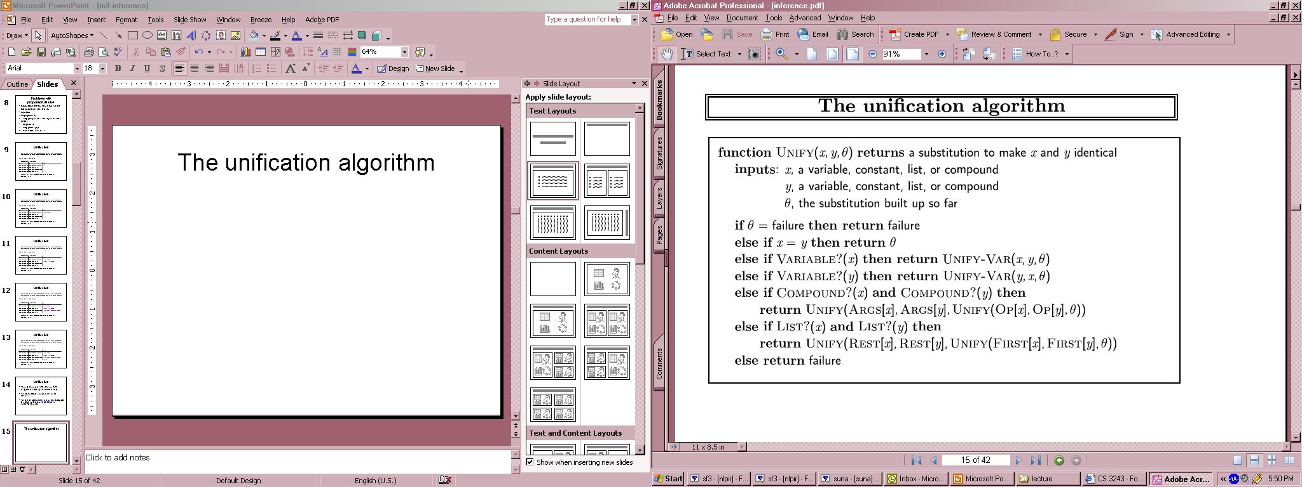
The unification algorithm

Slide 67
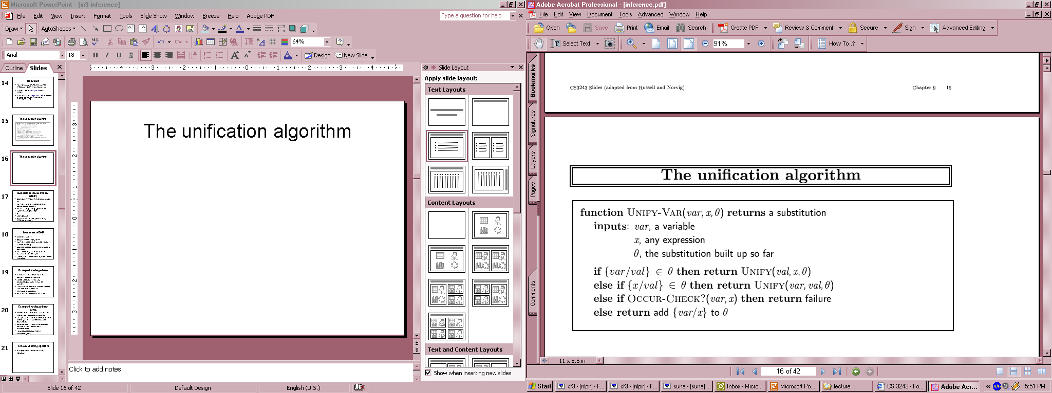
The unification algorithm

Slide 68
Another Example
Example
p=Eats(x,y), q=Eats(x,Blub), possible if θ = {y/Blub}
p=Eats(Martin,y), q=Eats(x,Blub), possible if θ = {x/Martin,y/Blub}
p=Eats(Martin,y), q=Eats(y,Blub), fails because Martin≠Blub
Subsumption
Unification works not only when two things are the same but also when one of them subsumes the other one
Example: All cats eat fish, Martin is a cat, Blub is a fish

Slide 69
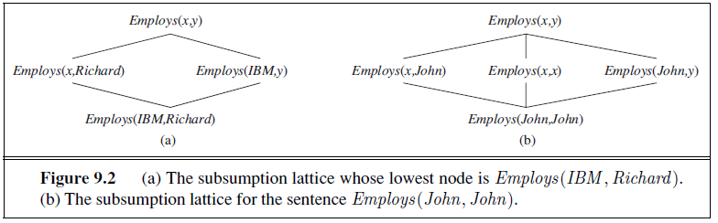
Subsumption Lattice

Slide 70
Generalized Modus Ponens (GMP)
p₁', p₂', … , p_{n}', ( p₁ ∧ p₂ ∧ … ∧ p_{n} ⇒q)
qθ
p₁' is King(John) p₁ is King(x)
p₂' is Greedy(y) p₂ is Greedy(x)
θ is {x/John,y/John} q is Evil(x)
q θ is Evil(John)
GMP used with KB of definite clauses (exactly one positive literal)
All variables assumed universally quantified
where p_{i}'θ = p_{i} θ for all i

Slide 71
Soundness of GMP
Need to show that
p₁', …, p_{n}', (p₁ ∧ … ∧ p_{n} ⇒ q) ╞ qθ
provided that p_{i}'θ = p_{i}θ for all I
Lemma: For any sentence p, we have p ╞ pθ by UI
(p₁ ∧ … ∧ p_{n} ⇒ q) ╞ (p₁ ∧ … ∧ p_{n} ⇒ q)θ = (p₁θ ∧ … ∧ p_{n}θ ⇒ qθ)
p₁', \; …, \;p_{n}' ╞ p₁' ∧ … ∧ p_{n}' ╞ p₁'θ ∧ … ∧ p_{n}'θ
From 1 and 2, qθ follows by ordinary Modus Ponens

Slide 72
Example knowledge base
The law says that it is a crime for an American to sell weapons to hostile nations. The country Nono, an enemy of America, has some missiles, and all of its missiles were sold to it by Colonel West, who is American.
Prove that Col. West is a criminal

Slide 73
Example knowledge base (contd.)
... it is a crime for an American to sell weapons to hostile nations:
American(x) ∧ Weapon(y) ∧ Sells(x,y,z) ∧ Hostile(z) ⇒ Criminal(x)
Nono … has some missiles, i.e., ∃x Owns(Nono,x) ∧ Missile(x)
Owns(Nono,M₁) and Missile(M₁)
… all of its missiles were sold to it by Colonel West
Missile(x) ∧ Owns(Nono,x) ⇒ Sells(West,x,Nono)
Missiles are weapons: Missile(x) ⇒ Weapon(x)
An enemy of America counts as "hostile“:
Enemy(x,America) ⇒ Hostile(x)
West, who is American … American(West)
The country Nono, an enemy of America … Enemy(Nono,America)

Slide 74
“The law says that it is a crime for an American to sell weapons to a hostile nation. The country Nono, an enemy of America, has some missiles, and all of its missiles were sold to it by Colonel West, who is an American.” Prove Colonel West is a criminal.
“The law says that it is a crime for an American to sell weapons to a hostile nation.”
1. ∀x,y,z american(x) ∧ weapon(y) ∧ nation(z) ∧ hostile(z) ∧ sells(x,y,z) → criminal(x)
“The country Nono is an enemy of America.”
2. nation(Nono)
3. enemy(Nono,America)
4. ∀x nation(x) ∧ hostile(x,America) → hostile(x)
“The country Nono has some missiles.”
5. ∃x missile(x) ∧ owns(Nono,x)
6. ∀x missile(x) → weapon(x)
“All of Non’s missiles were sold to it by Colonel West.”
7. ∀x missile(x) ∧ owns(Nono,x) → sells(West,x,Nono)

Slide 75
“Colonel West is an American.”
8. American(West)
9. missile(m₁) ∧ owns(Nono,m1) [existential instantiation/skolemization of 5, q={x/m₁}]
10. missile(m₁) [and elimination on 9]
11. weapon(m₁) [modus ponens on 6 an 10, q={x/m₁}]
12. hostile(Nono) [modus ponens on 2, 3, and 4, q={x/m₁}]
13. sells(West, m₁,Nono) [modus ponens on 7 an 9, q={x/m₁}]
14. criminal(West) [modus ponens on 1, 8, 2, 12, 11, and 13, q={x/West,y/m₁,z/Nono }]

Slide 76
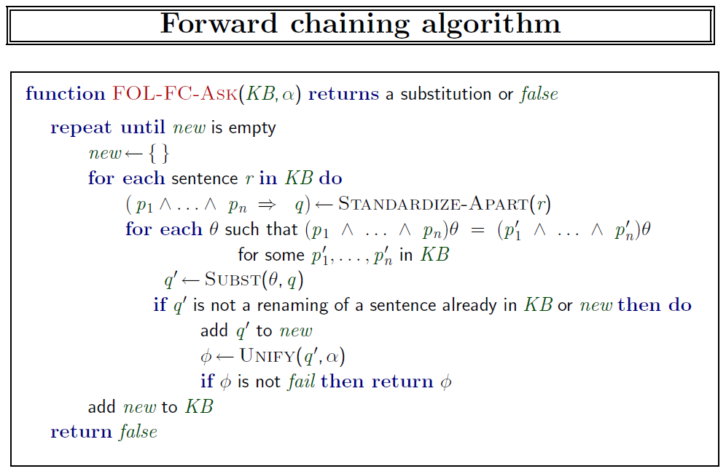

Slide 77
Forward chaining proof

Slide 78
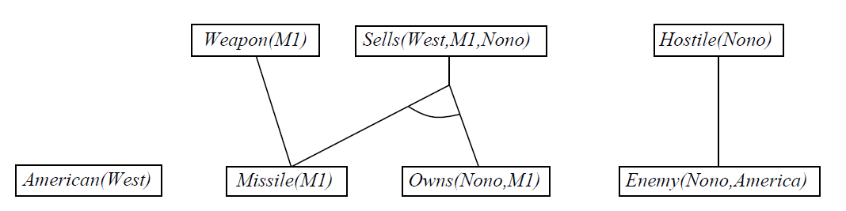
Forward chaining proof

Slide 79
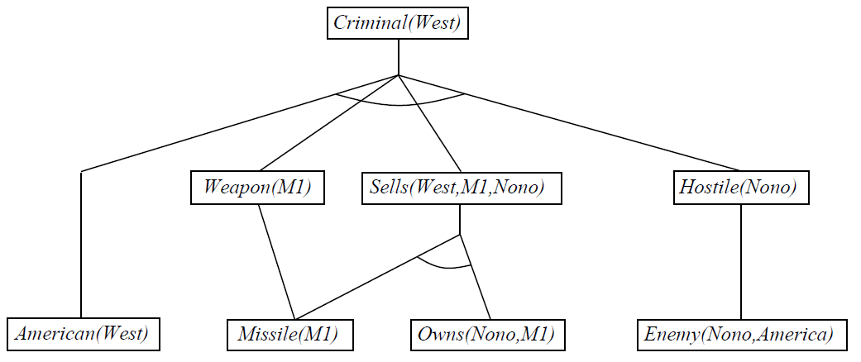
Forward chaining proof

Slide 80
Properties of forward chaining
Sound and complete for first-order definite clauses
Datalog = first-order definite clauses + no functions
FC terminates for Datalog in finite number of iterations
May not terminate in general if α is not entailed
This is unavoidable: entailment with definite clauses is semidecidable

Slide 81
Efficiency of Forward Chaining
Incremental forward chaining: no need to match a rule on iteration k if a premise wasn't added on iteration k-1
⇒ match each rule whose premise contains a newly added positive literal
Matching itself can be expensive:
Database indexing allows O(1) retrieval of known facts
e.g., query Missile(x) retrieves Missile(M₁)
Forward chaining is widely used in deductive databases

Slide 82
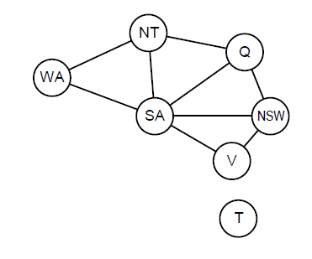
Hard matching example
Diff(wa,nt) ∧ Diff(wa,sa) ∧ Diff(nt,q) ∧ Diff(nt,sa) ∧ Diff(q,nsw) ∧ Diff(q,sa) ∧ Diff(nsw,v) ∧ Diff(nsw,sa) ∧ Diff(v,sa) ⇒ Colorable()
Diff(Red,Blue) Diff (Red,Green) Diff(Green,Red) Diff(Green,Blue) Diff(Blue,Red) Diff(Blue,Green)
Colorable() is inferred iff the CSP has a solution
CSPs include 3SAT as a special case, hence matching is NP-hard

Slide 83
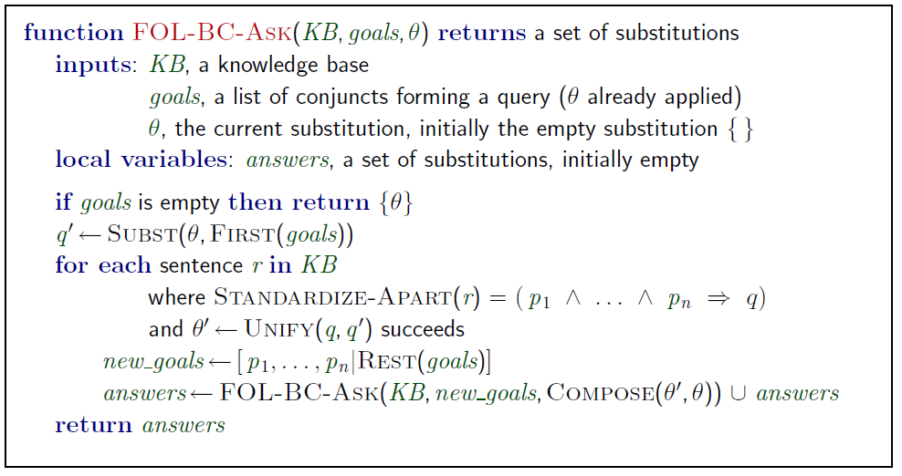
Backward chaining algorithm
SUBST(COMPOSE(θ₁, θ₂), p) = SUBST(θ₂, SUBST(θ₁, p))

Slide 84
Backward chaining example

Slide 85
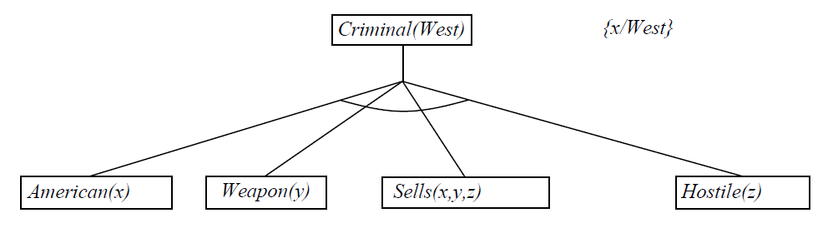
Backward chaining example

Slide 86
Backward chaining example

Slide 87
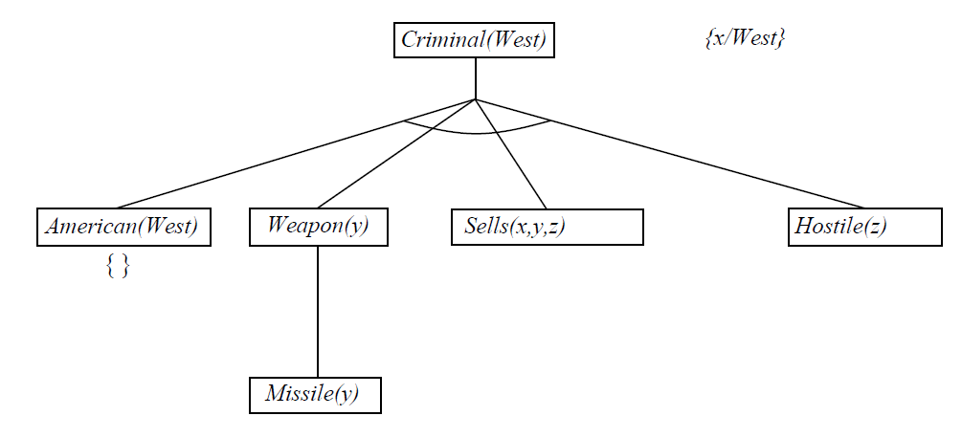
Backward chaining example

Slide 88
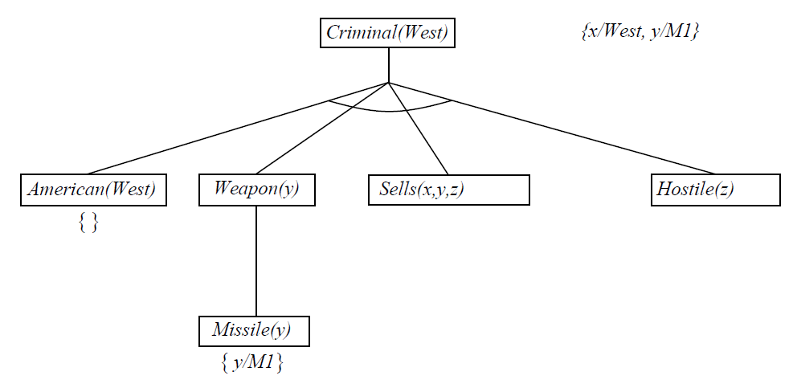
Backward chaining example

Slide 89
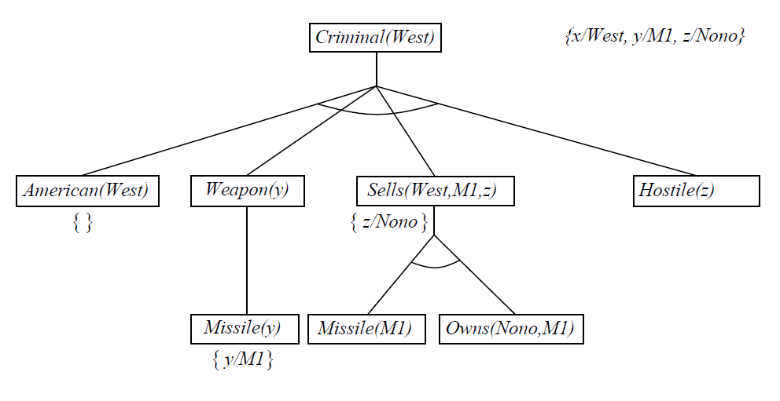
Backward chaining example

Slide 90
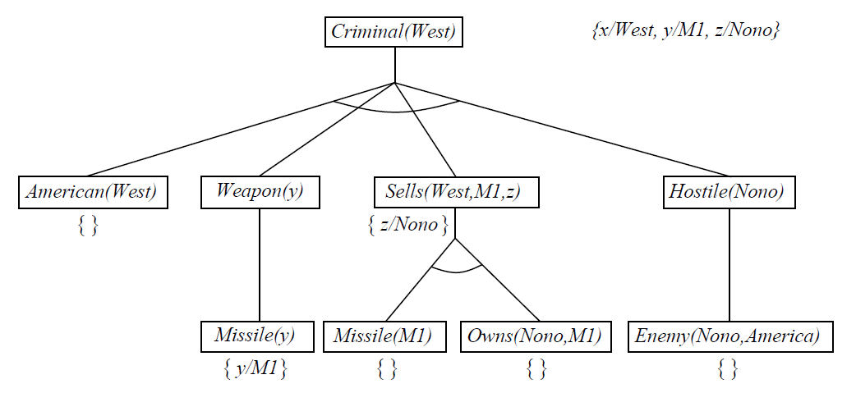
Backward chaining example

Slide 91
Properties of backward chaining
Depth-first recursive proof search: space is linear in size of proof
Incomplete due to infinite loops
⇒ fix by checking current goal against every goal on stack
Inefficient due to repeated subgoals (both success and failure)
⇒ fix using caching of previous results (extra space)
Widely used for logic programming

Slide 92
Logic programming: Prolog
Algorithm = Logic + Control
Basis: backward chaining with Horn clauses + bells & whistles
Widely used in Europe, Japan (basis of 5th Generation project)
Compilation techniques ⇒ 60 million LIPS
Program = set of clauses = head :- literal₁, … literal_{n}.
criminal(X) :- american(X), weapon(Y), sells(X,Y,Z), hostile(Z).
Depth-first, left-to-right backward chaining
Built-in predicates for arithmetic etc., e.g., X is Y*Z+3
Built-in predicates that have side effects (e.g., input and output
predicates, assert/retract predicates)
Closed-world assumption ("negation as failure")
e.g., given alive(X) :- not dead(X).
alive(joe) succeeds if dead(joe) fails

Slide 93
Prolog
Appending two lists to produce a third:
append([],Y,Y).
append([X|L],Y,[X|Z]) :- append(L,Y,Z).
query: append(A,B,[1,2]) ?
answers: A=[] B=[1,2]
A=[1] B=[2]
A=[1,2] B=[]

Slide 94
Resolution in FOL
FOL includes non-Horn clauses, e.g.,
∀x: Country(x) → ∃y: CapitalOf(y,x)
Strategy (just like in propositional logic)
Convert all formulas to CNF
Apply resolution rule

Slide 95
Resolution: brief summary
Full first-order version:
l₁ ∨ ··· ∨ l_{k}, m₁ ∨ ··· ∨ m_{n}
(l₁ ∨ ··· ∨ l_{i-1} ∨ l_{i+1} ∨ ··· ∨ l_{k} ∨ m₁ ∨ ··· ∨ m_{j-1} ∨ m_{j+1} ∨ ··· ∨ m_{n})θ
where Unify(l_{i}, ¬m_{j}) = θ.
The two clauses are assumed to be standardized apart so that they share no variables.
For example,
¬Rich(x) ∨ Unhappy(x) Rich(Ken)
Unhappy(Ken)
with θ = {x/Ken}
Apply resolution steps to CNF(KB ∧ ¬α); complete for FOL

Slide 96
Conversion to CNF
Everyone who loves all animals is loved by someone:
∀x [∀y Animal(y) ⇒ Loves(x,y)] ⇒ [∃y Loves(y,x)]
1. Eliminate biconditionals and implications
∀x [¬∀y ¬Animal(y) ∨ Loves(x,y)] ∨ [∃y Loves(y,x)]
2. Move ¬ inwards: ¬∀x p ≡ ∃x ¬p, ¬ ∃x p ≡ ∀x ¬p
∀x [∃y ¬(¬Animal(y) ∨ Loves(x,y))] ∨ [∃y Loves(y,x)]
∀x [∃y ¬¬Animal(y) ∧ ¬Loves(x,y)] ∨ [∃y Loves(y,x)]
∀x [∃y Animal(y) ∧ ¬Loves(x,y)] ∨ [∃y Loves(y,x)]

Slide 97
Conversion to CNF contd.
Standardize variables: each quantifier should use a different one
∀x [∃y Animal(y) ∧ ¬Loves(x,y)] ∨ [∃z Loves(z,x)]
Skolemize: a more general form of existential instantiation.
Each existential variable is replaced by a Skolem function of the enclosing universally quantified variables: ∀x [Animal(F(x)) ∧ ¬Loves(x,F(x))] ∨ Loves(G(x),x)
Drop universal quantifiers:
[Animal(F(x)) ∧ ¬Loves(x,F(x))] ∨ Loves(G(x),x)
Distribute ∨ over ∧ :
[Animal(F(x)) ∨ Loves(G(x),x)] ∧ [¬Loves(x,F(x)) ∨ Loves(G(x),x)]

Slide 98
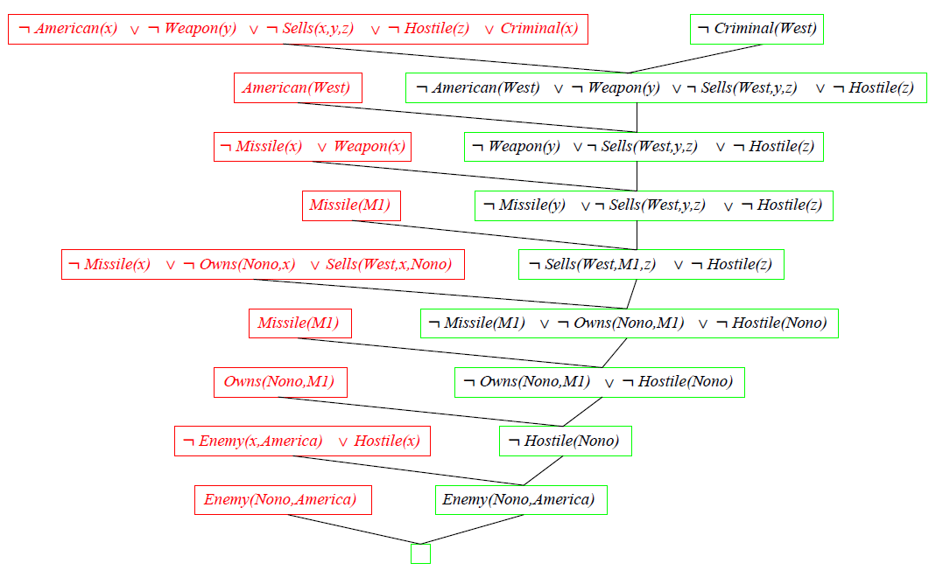
Resolution proof: definite clauses

Slide 99
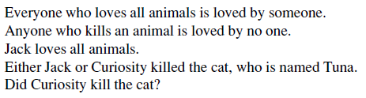

Slide 100
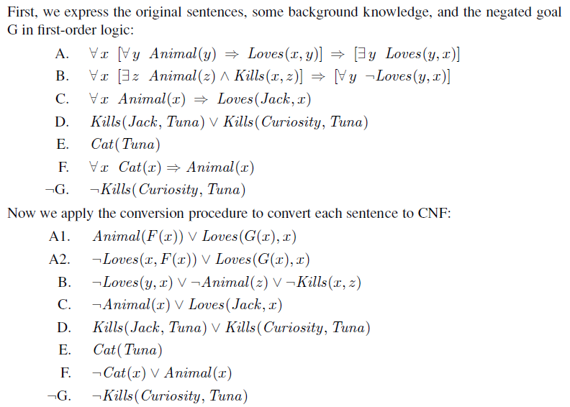

Slide 101
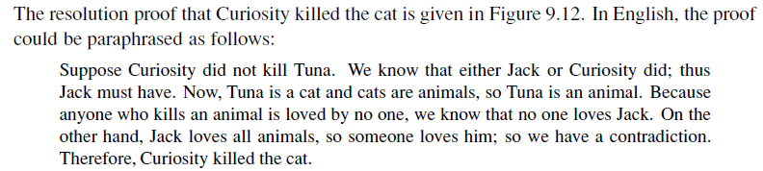

Slide 102
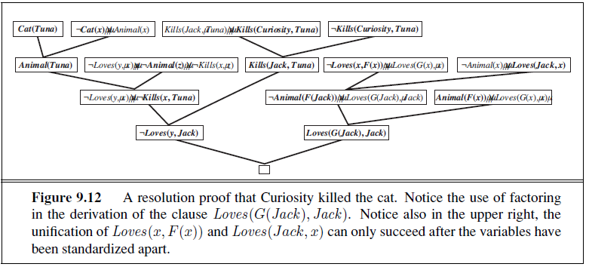

Slide 103
AI

